Slide 1
PTA/OTA 106
Unit 2 Lecture 3

Slide 2
Digestive Functions
Ingestion
  intake of food
Digestion
  breakdown of molecules
Absorption
  uptake nutrients into blood/lymph
Defecation
  elimination of undigested material

Slide 3
Stages of Digestion
Mechanical digestion
  physical breakdown of food into smaller particles
  teeth and churning action of stomach and intestines
Chemical digestion
  series of hydrolysis reactions that break macromolecules into their monomers
  enzymes from saliva, stomach, pancreas and intestines
  results
    polysaccharides into monosaccharides
    proteins into amino acids
    fats into glycerol and fatty acids

Slide 4
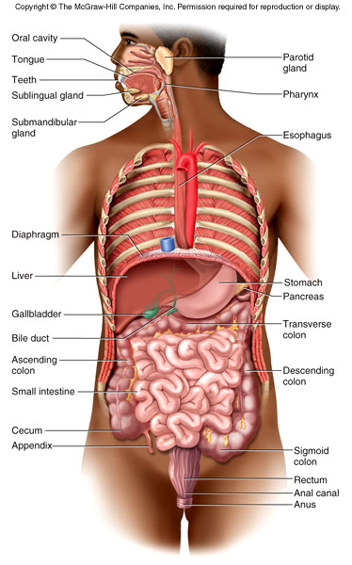
Figure 25.1

Slide 5
Subdivisions of Digestive System
Digestive tract (GI tract)
  30 foot long tube extending from
  mouth to anus
Accessory organs
  teeth, tongue, liver, gallbladder,
  pancreas, salivary glands

Slide 6
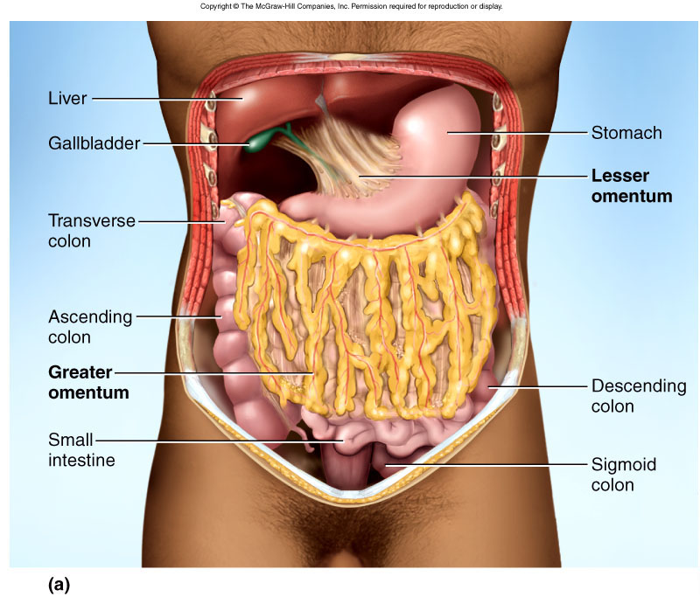
Lesser and Greater Omentum
Lesser - attaches stomach to liver
Greater - covers small intestines like an apron

Slide 7
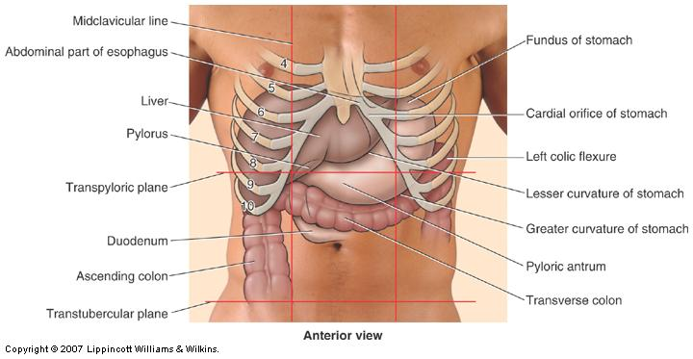

Slide 8
Stomach
Mechanically breaks up food, liquifies food and begins chemical digestion of protein and fat
  resulting soupy mixture is called chyme
Does not absorb significant amount of nutrients
  absorbs aspirin and some lipid-soluble drugs

Slide 9
Gross Anatomy of Stomach
Muscular sac (internal volume from 50ml to 4L)
  J - shaped organ with lesser and greater curvatures
  regional differences
    cardiac region just inside cardiac orifice
    fundus - domed portion superior to esophageal opening
    body - main portion of organ
    pyloric region - narrow inferior end
      antrum and pyloric canal
Pylorus - opening to duodenum
  thick ring of smooth muscle forms a sphincter

Slide 10
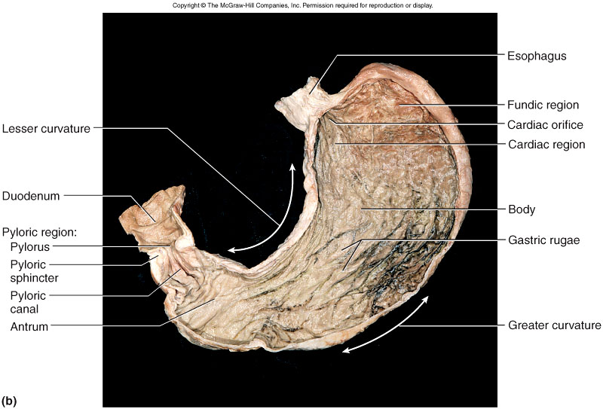
Gross Anatomy of Stomach

Slide 11
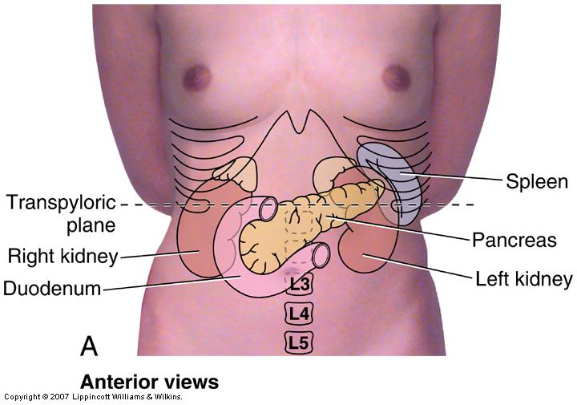
Liver, Gallbladder and Pancreas
All release important secretions into small intestine to continue digestion

Slide 12
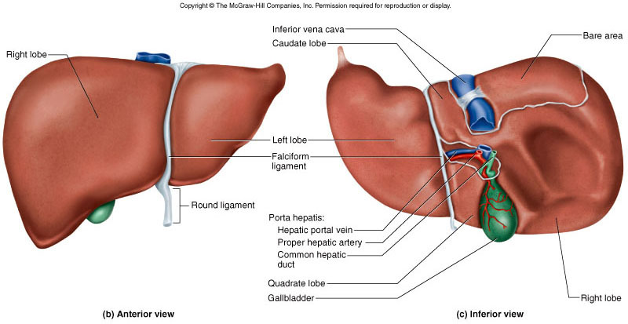
Gross Anatomy of Liver
3 lb. organ located inferior to the diaphragm
4 lobes - right, left, quadrate and caudate
  falciform ligament separates left and right
  round ligament, remnant of umbilical vein
Gallbladder adheres to ventral surface between right and quadrate lobes

Slide 13
Ducts of Gallbladder, Liver, Pancreas
Bile passes from bile canaliculi between cells to bile ductules to right and left hepatic ducts
Right and left ducts join outside liver to form common hepatic duct
Cystic duct from gallbladder joins common hepatic duct to form bile duct
Duct of pancreas and bile duct combine to form hepatopancreatic ampulla emptying into duodenum at major duodenal papilla
  sphincter of Oddi (hepatopancreatic sphincter) regulates release of bile and pancreatic juice

Slide 14
Ducts of Gallbladder, Liver, Pancreas
Bile passes from bile canaliculi between cells to bile ductules to right and left hepatic ducts
Right and left ducts join outside liver to form common hepatic duct
Cystic duct from gallbladder joins common hepatic duct to form bile duct
Duct of pancreas and bile duct combine to form hepatopancreatic ampulla emptying into duodenum at major duodenal papilla
  sphincter of Oddi (hepatopancreatic sphincter) regulates release of bile and pancreatic juice

Slide 15
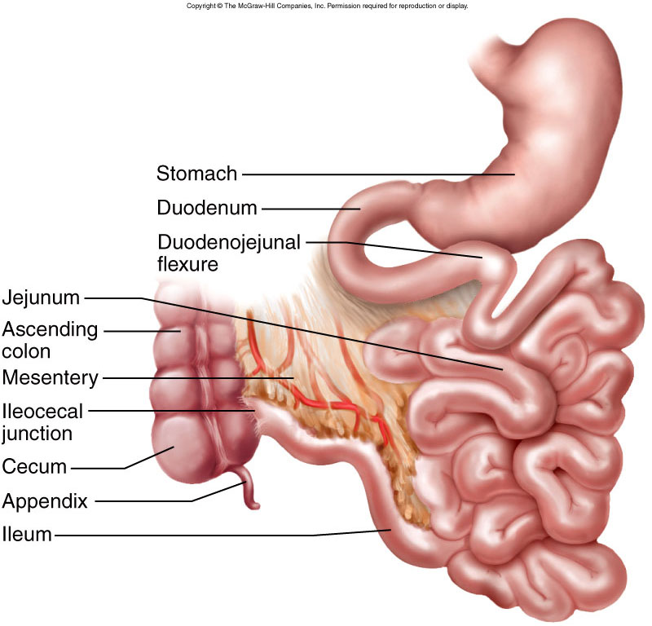
Small Intestine
Nearly all chemical digestion and nutrient absorption occurs in small intestine

Slide 16
Small Intestine
Duodenum curves around head of pancreas (10 in.)
  retroperitoneal along with pancreas
  receives stomach contents, pancreatic juice and bile
  neutralizes stomach acids, emulsifies fats, pepsin inactivated by pH increase, pancreatic enzymes
Jejunum - next 8 ft. (in upper abdomen)
  has large tall circular folds; walls are thick, muscular
  most digestion and nutrient absorption occur here
Ileum - last 12 ft. (in lower abdomen)
  has peyer’s patches – clusters of lymphatic nodules
  ends at ileocecal junction with large intestine

Slide 17
Water Balance
Digestive tract receives about 9 L of water/day
  .7 L in food, 1.6 L in drink, 6.7 L in secretions
  8 L is absorbed by small intestine and 0.8 L by large intestine
Water is absorbed by osmosis following the absorption of salts and organic nutrients
Diarrhea occurs when too little water is absorbed
  feces pass through too quickly if irritated
  feces contains high concentrations of a solute (lactose)

Slide 18
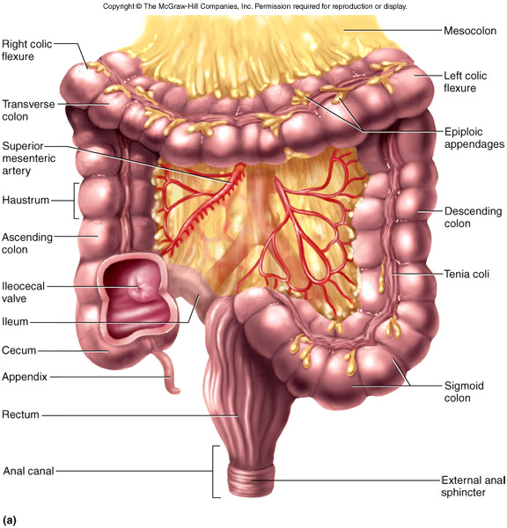
Anatomy of Large Intestine

Slide 19
Gross Anatomy of Large Intestine
5 feet long and 2.5 inches in diameter in cadaver
Begins as cecum and appendix in lower right corner
Ascending, transverse and descending colon frame the small intestine
Sigmoid colon is S-shaped portion leading down into pelvis
Rectum - straight portion ending at anal canal

Slide 20
Absorption and Motility
Transit time is 12 to 24 hours
  reabsorbs water and electrolytes
Feces consist of water and solids (bacteria, mucus, undigested fiber, fat and sloughed epithelial cells
Haustral contractions occur every 30 minutes
  distension of a haustrum stimulates it to contract
Mass movements occur 1 to 3 times a day
  triggered by gastrocolic and duodenocolic reflexes
    filling of the stomach and duodenum stimulates motility
    moves residue for several centimeters with each contraction

Slide 21
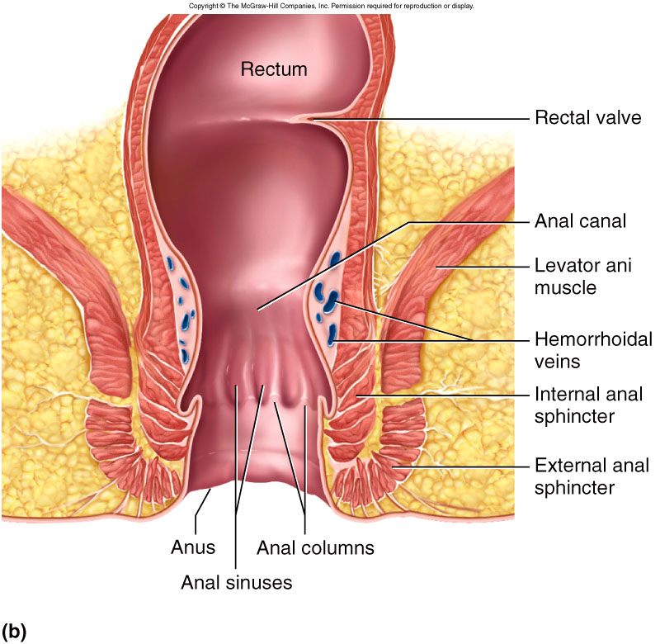
Anatomy of Anal Canal
Anal canal is 3 cm total length
Anal columns are longitudinal ridges separated by mucus secreting anal sinuses
Hemorrhoids are permanently distended veins

